Slide 1
Streaming Uber Taxi Demand Prediction
Liz Aharonian & Ori Ben-Zaken supervisors: Barak Bar-Orion, Yohana Khoury, Yoav Einav, Tal Doron

Slide 2

Motivation:
Our goal is to predict demand per time interval for Uber Taxi Ride, using ML and big data processing tools.
The demand parameter is calculated according to time intervals and area, this gives two major advantages to our predicting model:
Help the model's users to know which area they should give service.
Using a simple function based on the demand to predict and calculate the fare amount.

Slide 3


Technologies:
Machine Learning (Apache Spark and ML model – using sklearn library).
Interactive Development (Apache Zeppelin).
Prediction of real time records (Kafka streaming).
BI (Tableau).
Packaging the model components using Docker.

Slide 4
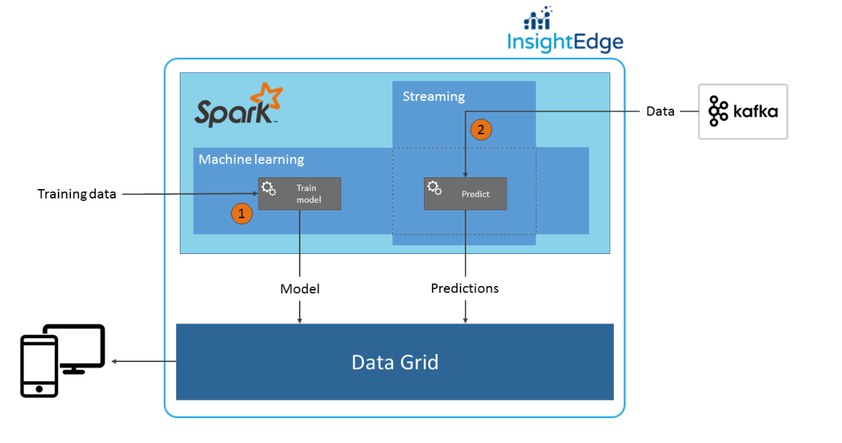
Architecture:

Slide 5
Project's components and milestones:
Milestone #1 : Find relevant data.
Milestone #2: Data cleansing.
Milestone #3: Training ML model.
Milestone #4: Data streaming.
Milestone #5: Running the model.
Milestone #6: Visualization of the data – BI.
Milestone #7: packaging the model.

Slide 6

Milestone #1 : Find relevant data
After examining different taxi trips datasets we decided to take our data from 2014_Uber_Data, can be found here.
Our dataset contains records of ~360K uber taxis trips in NYC. Each record contains the following details: pickup date and time, pickup latitude, pickup longitude and region code.

Slide 7
Milestone #2: Data cleansing
We performed full data cleansing that includes: removing records with Null values and removing columns that more than half to their values are Null or empty. In our case, no column was removed.
Our model target is to predict the demand for taxi per time interval and area. In order to do so we added the “demand” feature. We counted all of the taxi trips that occurred in a certain region and certain 10-minutes time interval. The result was added to each of the relevant trip record.
Added more features in order to help the prediction. For each record we added the features: is_Holiday, is_Weekend according to the trip date.

Slide 8
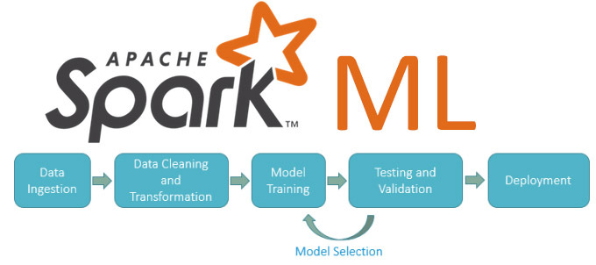
Milestone #3: Training ML model
We chose randomly 50K trip records as our dataset for the model. Splitting of course the dataset to training set and validation set.
We tried many regression models including neural nets models, reached to the best results with Random Forest Regression model.
The model is a spark model which can perform it's work and computation in distributed system.

Slide 9
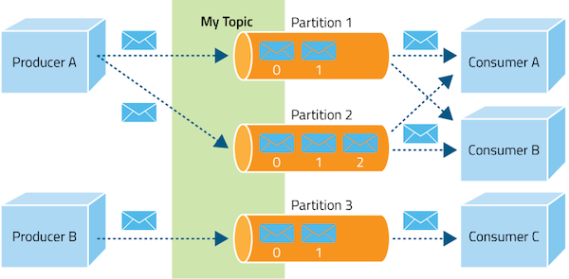
Milestone #4: Data streaming
Using Apache Kafka in order to stream the data in real-time.
Kafka aims to provide a unified, high-throughput, low-latency platform for handling real-time data feeds, making it highly valuable for enterprise infrastructures to process streaming data.

Slide 10
Milestone #5: running the model
Using trained serialized model in order to predict demand per time interval and area on new examples which hasn't been seen by the model.

Slide 11
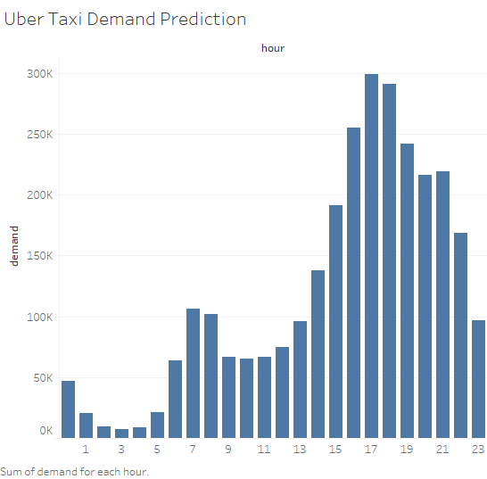
Milestone #6: Visualization of the data - BI
Using Tableau in order to present the model results and more analytics on the data.
Tableau is a BI tool uses to ask new questions on our data, spot trends, identify opportunities, and make data-driven decisions with confidence.

Slide 12
Milestone #7: packaging the model
Package our model and all its dependencies using Docker, a computer program that performs operating-system-level virtualization.
We are going to use it, so that our project would not be depend on specific operating system.
All the project components: ZooKeeper servers, Kafka server, InsightEdge and our model endpoint can be installed and running in a virtual environment with less than 5 commands!

Slide 13
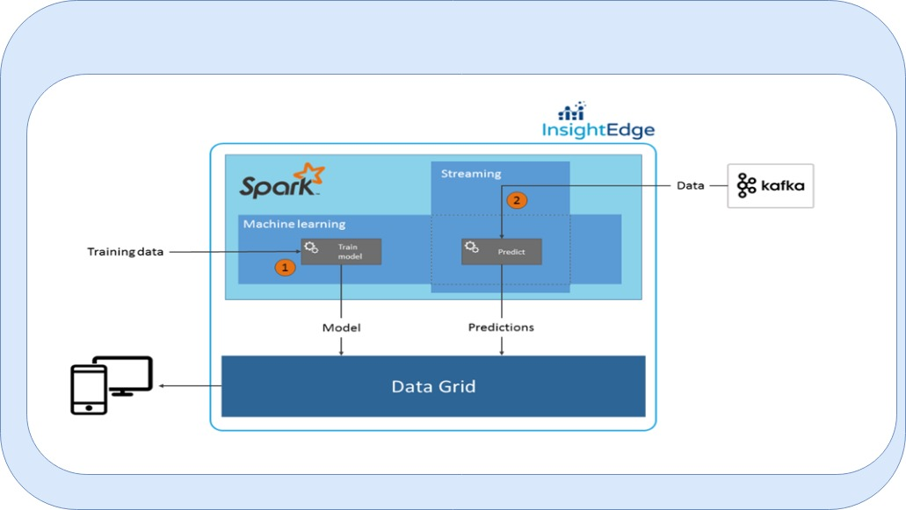

FULL Architecture:

